Slide 1

2012 Heirloom Tomato Pictures
Kathryn Fontenot, PhD
LSU AgCenter
School of Plant, Environmental and Soil Sciences

Slide 2
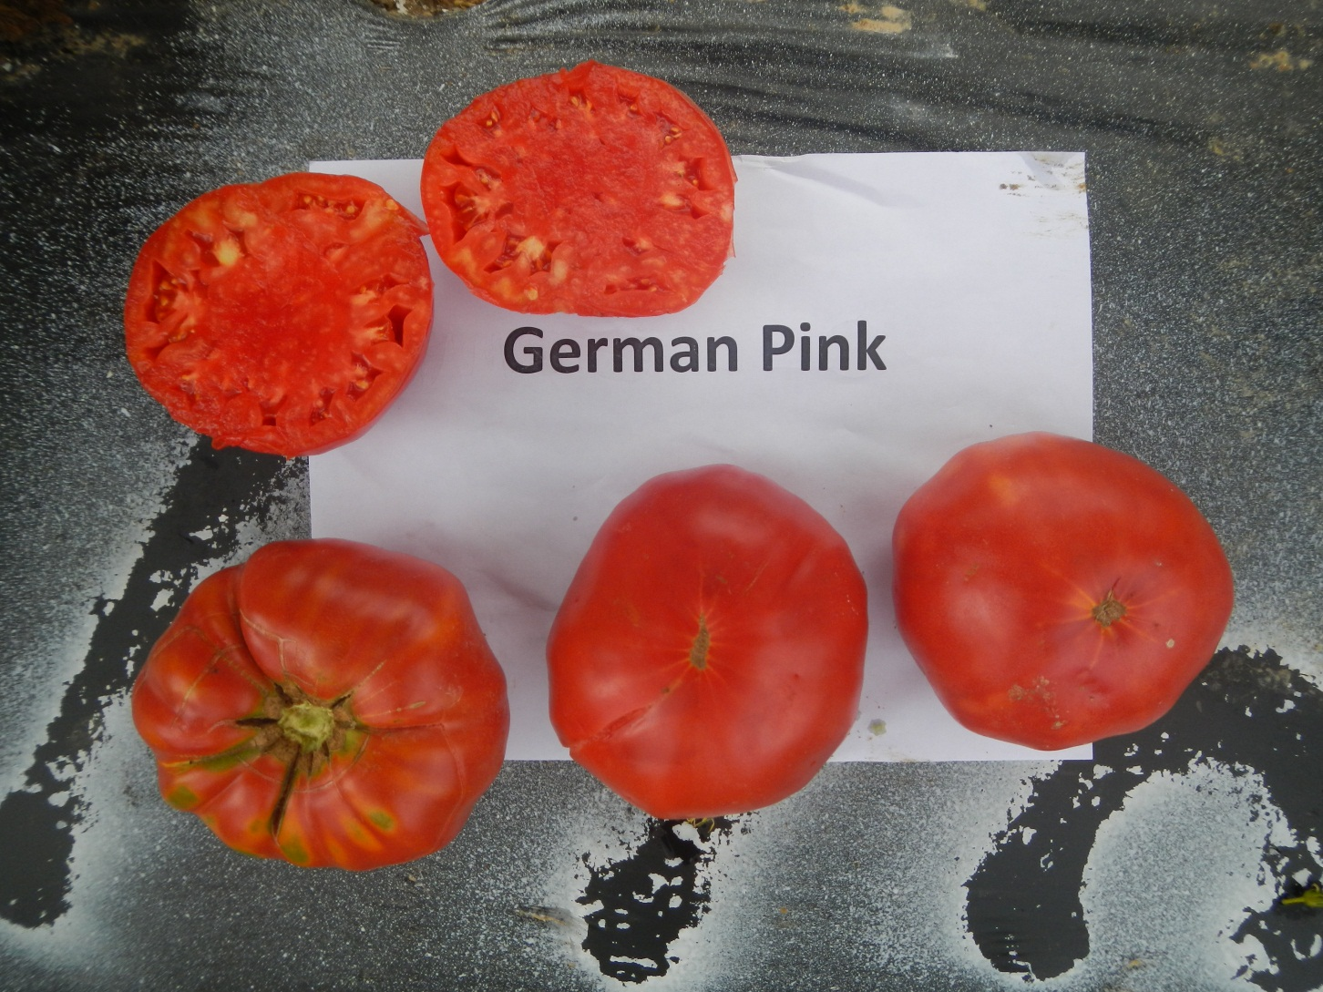
Pink German

Slide 3
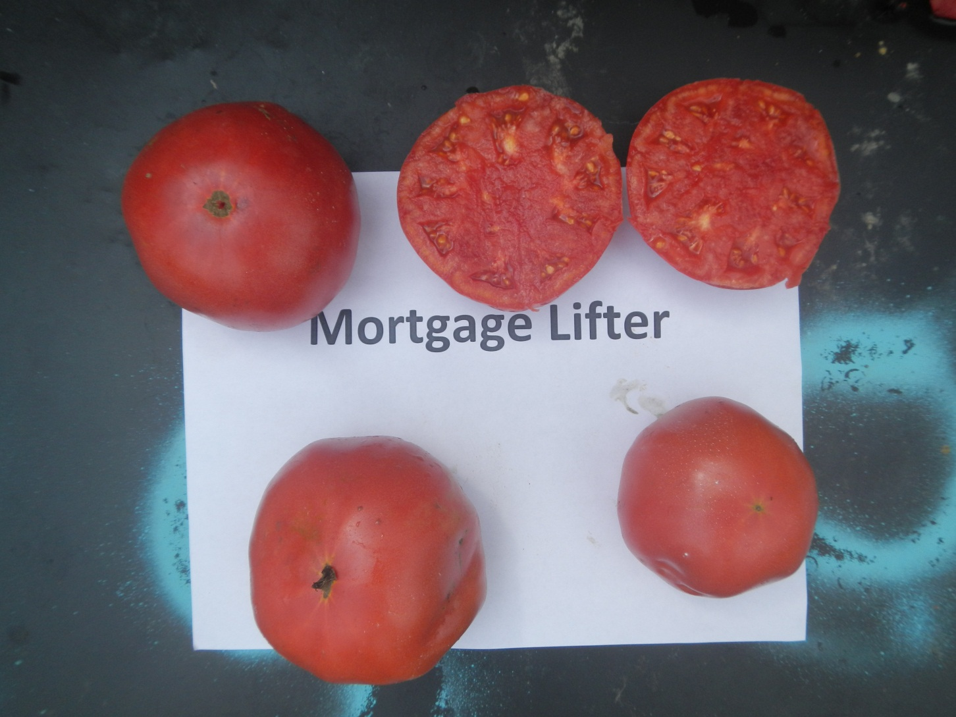
Mortgage Lifter

Slide 4
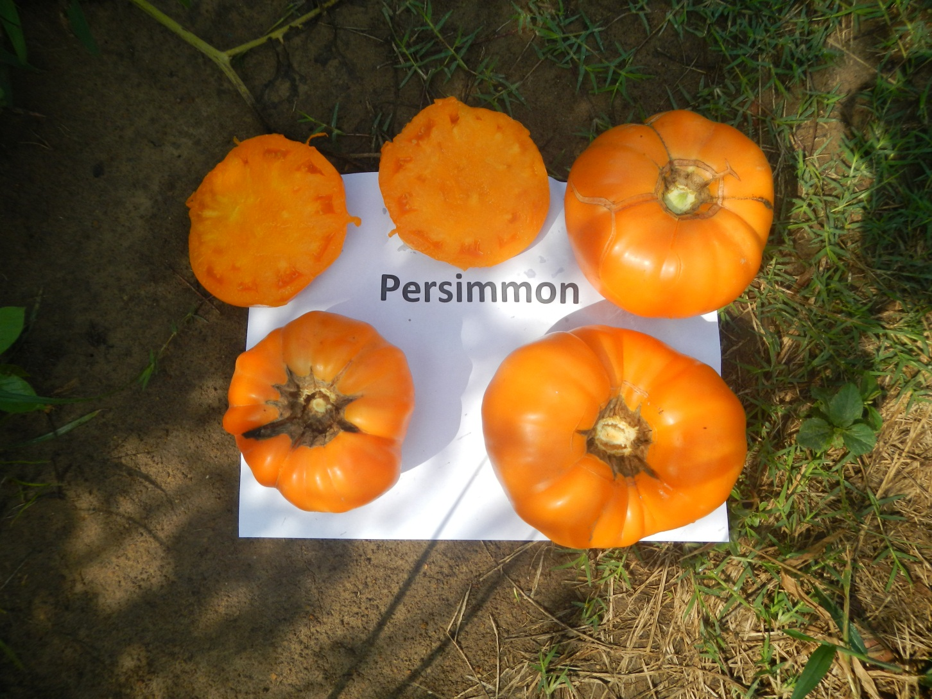
Persimmon

Slide 5
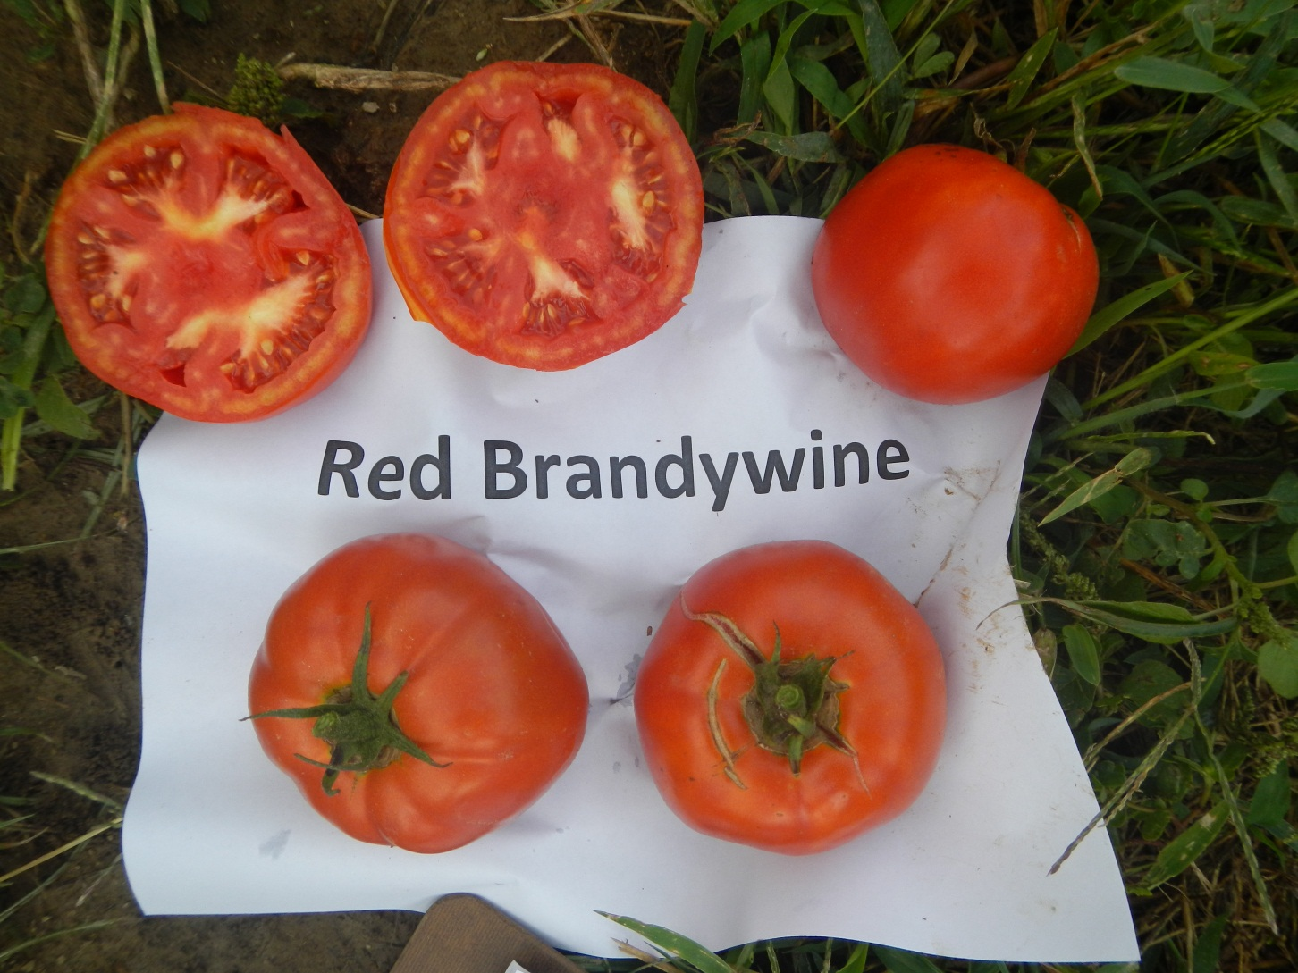
Red Brandywine

Slide 6
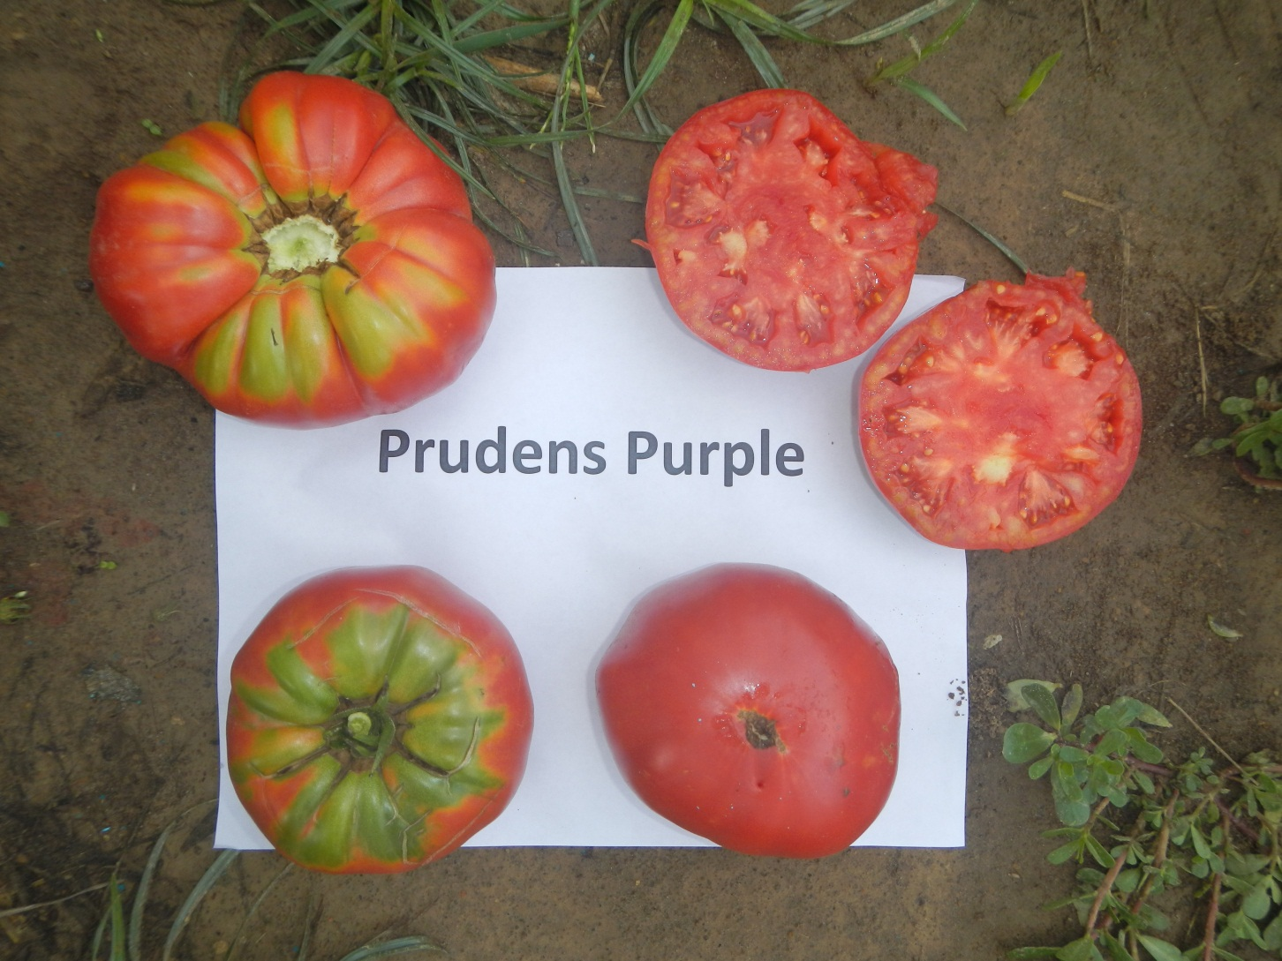
Prudens Purple

Slide 7
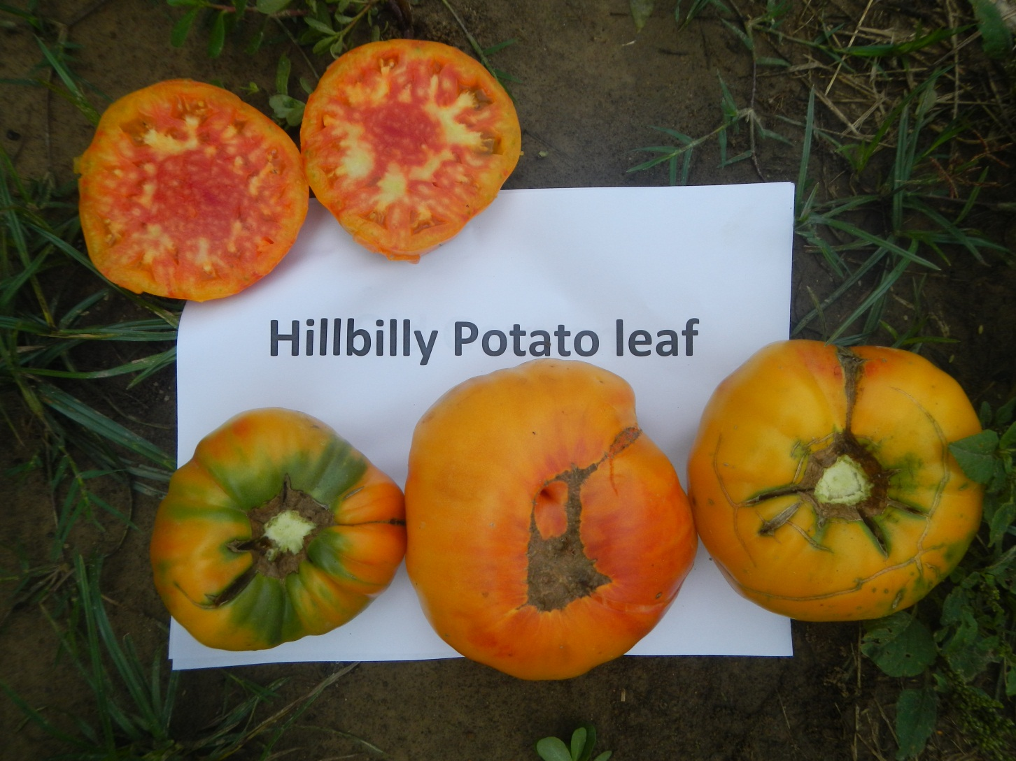
Hillbilly Potato Leaf

Slide 8
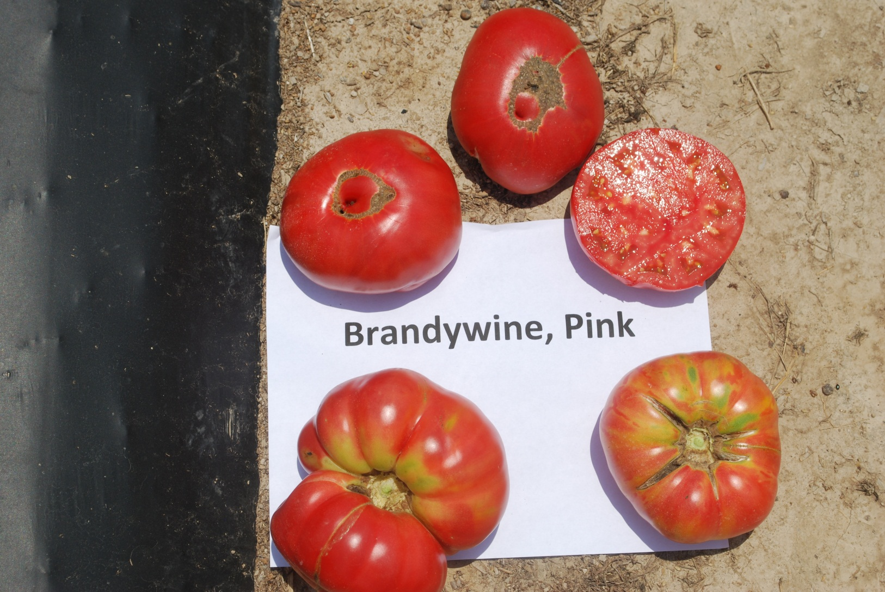
Pink Brandywine

Slide 9
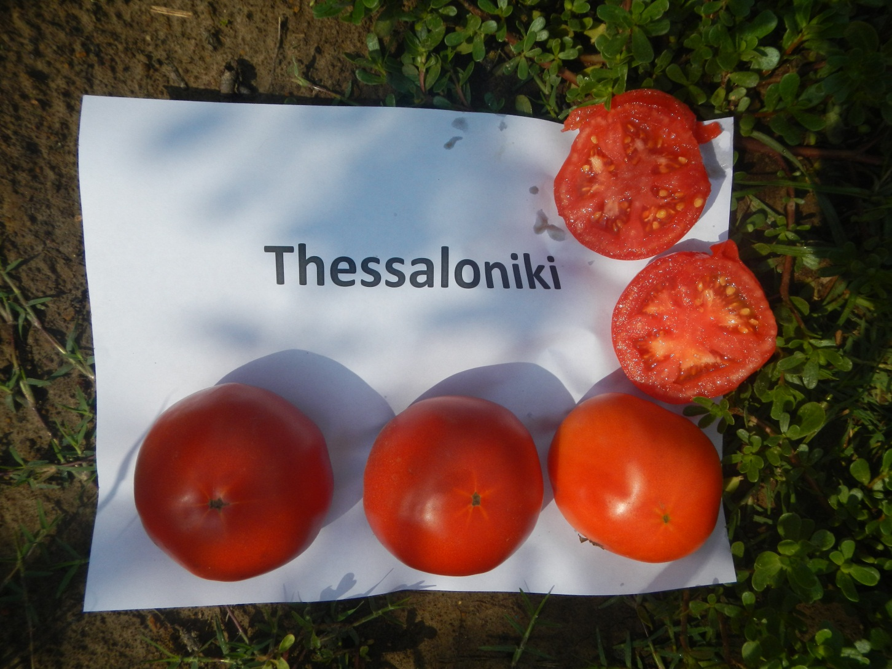
Thessaloniki

Slide 10
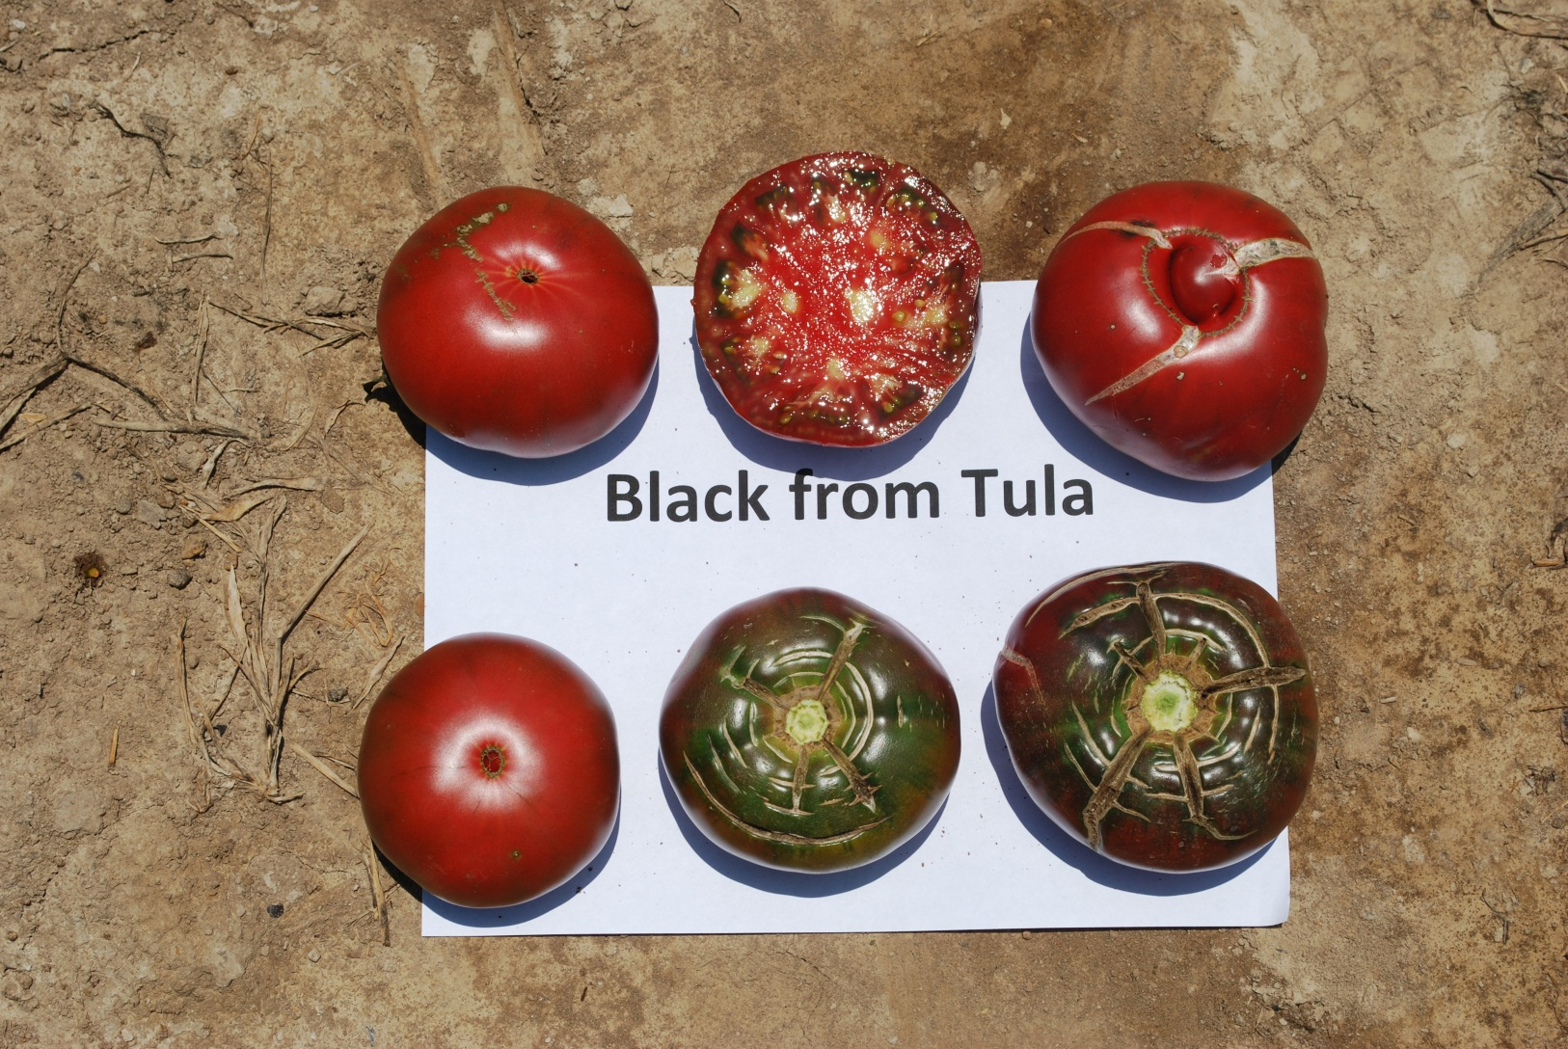
Black from Tula

Slide 11
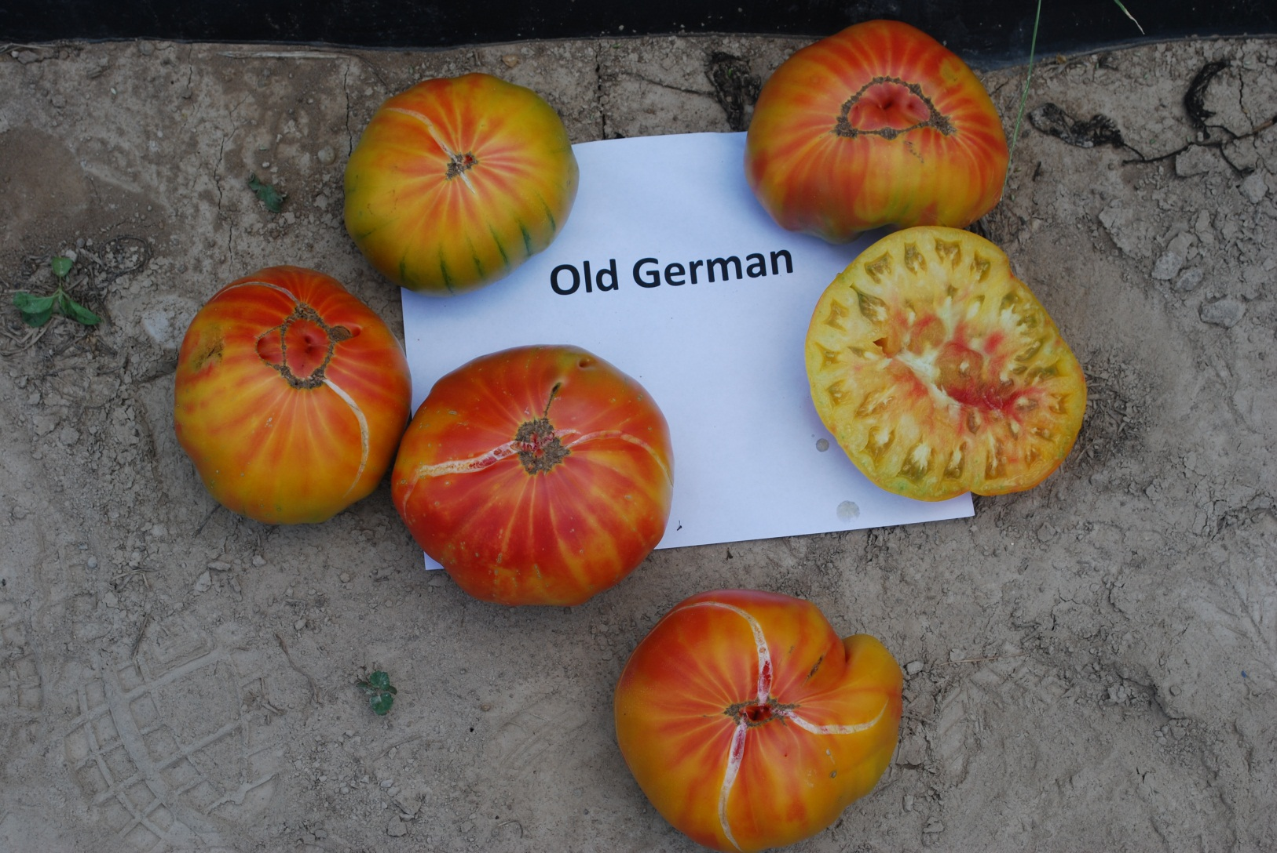
Old German

